Slide 1

CMS Migration
Salesforce Contentful
Salesforce Studio

Slide 2

Index
1
Executive Summary
2
Project Scope - Web
5
Project Scope - API
3
Proposed Solution - Web
6
Team, Timeline & Commercials - API
4
Team, Timeline, Commercials - Web
7
Appendix
SF Studiom Customer Success, Methodology

Slide 3
Executive Summary
The objective of this proposal is to migrate from Adobe to Contentful as Expedia Group's central content management system (CMS) to streamline multi-channel publishing, localization, and personalization.
Evaluation Framework: Migrate 46 core CMS capabilities across workflow, translation, multi-platform integration, and traceability to confirm operational efficiency and technical readiness for future scaling.
Notes:
Objective: Evaluate Contentful as Expedia Group's central content management system (CMS) to streamline multi-channel publishing, localization, and personalization.
Core Use Cases:
Cross-Channel Proof Point Consistency: Tests Contentful as a single source of truth where personalized content ("proof points") is authored once, tagged with metadata, translated into five locales, and fetched dynamically via a stable Content ID across channels like Salesforce Marketing Cloud (SFMC) and CRM/VMC.
Partner Web Content: Validates Contentful's ability to support rapid page authoring, component reuse, multi-language translation (German, French, Japanese, Swedish), previewing across breakpoints, and publishing for partner-facing web pages.
Evaluation Framework: Assesses Contentful against 46 core CMS capabilities across workflow, translation, multi-platform integration, and traceability to confirm operational efficiency and technical readiness for future scaling.

Slide 4
Salesforce
Partner Web
Project Scope

Slide 5
Scope: What moves from AEM
Four sites live in AEM today. Volumes come from the AEM inventory.
Site | Pages live | Source pages | Locales | Sessions / month
partner.expediagroup.com | 3,152 | 353 | 9 full-site, plus some translated landing pages | ~280k
host.vrbo.com | 100 | 2 | 19 | ~330k
escapia.com | 155 | 139 | 3 | ~22.5k
expediagroup.com | 41 | 41 | en-US only | ~8k
Volume to migrate
102,585
items in total · 13.46 GB
Content fragments
87,935
Images
13,163
5.65 GB
PDF
1,247
5.68 GB
Video
155
0.69 GB*
Other
85
1.43 GB
Notes
host.vrbo.com is also replicated to host.abritel.fr, host.fewo-direkt.de, hote.abritel.fr and gastgeber.fewo-direkt.de: 100 live pages counts all locales and all domains.
Source pages are unique pages; live pages count every locale. Sessions are the 2026 monthly average (host.vrbo.com live since July 1, 2026; expediagroup.com since May 11, 2026).
* Undercounted: some videos in the report have no file size. All are short clips (under 5 seconds, no audio).
Other: XML sitemaps and AEM viewer preset files.
Globant proprietary | Confidential information | Do not share without EXPLICIT Globant consent
‹#› |

Slide 6
Deliverables: Contentful setup
Key Activities
Platform
Set up the Contentful organisation, the partner web space, roles and SSO (depending on the tier).
Configure locales and fallback for the four sites: 9, 19, 3 and 1 locales.
Configure environments to change the model without disturbing authors, and to rehearse each migration run.
Content model
Model pages, sections and blocks as content types, mapped from the AEM component disposition.
Presentation fields hold roles, not colours, so a visual enhancement changes the front end and not the content.
Include the non-parity enhancements in the model
Workflow
Approval gates and roles, per space and per locale; workflows and tasks, scheduled publishing.
Translation route configured once EG chooses it (Babel Prime or a supported connector).
Audiences and experiences in Contentful Personalization, if the tier includes it.
Outputs & Assumptions
Outputs
Partner web space with the enhanced content model, ready for migration.
Locales, roles, approval gates and workflows set up for all four sites.
Environments for model changes and migration rehearsals.
Contentful configured to the tier EG licenses.
Assumptions
EG provides the Contentful organisation, roles for Globant and the tier and add-ons it chooses.
The non-parity enhancements are designed in Figma and the model is frozen before the end of the discovery phase.
If a capability is not in the tier, the solution works around it with more build; the gates stay the same.
EG chooses the translation route before the first translated locale.
Globant proprietary | Confidential information | Do not share without EXPLICIT Globant consent
‹#› |

Slide 7
Deliverables: Contentful custom development
Key Activities
Where configuration is not enough
Live preview. Contentful opens the preview but the front end is what it shows. Preview URLs and the click-to-edit tags are set up with the front end.
Custom workflows. Contentful workflows take a whole entry through their steps and publishing sets every locale live at once. Approving each locale on its own is built as an app in the editor.
Author interface customisations. Small apps in the editor for checks that look across entries, since Contentful validates one field at a time.
Translation connector. Only if EG chooses Babel Prime.
Outputs & Assumptions
Outputs
Live preview connected to the front end for every site.
Custom workflow app in the editor, with the approval gates agreed with EG.
Editor apps for cross-entry checks.
Assumptions
Each build has an owner after go-live; Globant owns it with the content model.
Contentful provides the platform side: environments, content model migrations and app hosting.
The list of custom workflows and checks is confirmed in discovery.
Globant proprietary | Confidential information | Do not share without EXPLICIT Globant consent
‹#› |

Slide 8
Deliverables: Front-end application
Key Activities
Application
Next.js (App Router) and Tailwind application, deployed with OpenNext to EG's AWS account.
Component library mapped from the content types, built from the Figma designs and on EG's design system (EGDS) components.
Locale routing, hreflang and locale-specific links for the sites' locales.
Rendering and preview
ISR for public pages, regenerated by the Contentful publish webhook; SSR for private sections.
Preview mode on a separate domain that runs the same code, reading unpublished content.
Parity
The analytics data layer and consent behave as they do on AEM today.
SEO parity: titles, canonicals, structured data, robots, redirects and sitemaps.
Lighthouse in the deployment pipeline; a build below the thresholds stops.
Outputs & Assumptions
Outputs
Four partner sites served by one reusable component library.
Page, section and block components with preview support.
Tracking and consent that match the current sites.
Assumptions
EG provides the Figma designs and the current component library as the baseline.
EG confirms which EGDS generation (1 or 2) the app consumes.
The supported Next.js version of the current OpenNext release is pinned; upgrades are planned.
Named EG owners for the app, the AWS infrastructure and on-call.
Globant proprietary | Confidential information | Do not share without EXPLICIT Globant consent
‹#› |

Slide 9
Deliverables: CDN, environments and pipelines
Key Activities
Edge
Akamai in front of AEM first, sending everything to it, then DNS moved once.
Routing by path and by cohort between AEM and the new front end, and the redirect map generated from the disposition log.
The new origin registered behind Akamai and Cloud Gate Proxy.
Environments on EG's AWS
Environments for the front end: accounts, IAM, networking, WAF and cost allocation.
Infrastructure as code for OpenNext (SST, Terraform or CDK).
Pipelines
CI/CD for the front end with Lighthouse, tests and the Next.js version checks.
Publish path: Contentful webhook, revalidation, queue, regeneration and cache purge.
Monitoring with Datadog and CloudWatch.
Outputs & Assumptions
Outputs
Akamai live in front of AEM before the first business case moves.
Development, test and production environments, with pipelines.
Rollback of any business case as a routing change at the edge, in minutes.
Assumptions
EG IT and DevOps provide the AWS accounts, delegated access for Globant and the environments, and DNS stays with EG.
Origin registration with EG's Edge team is ticket-based; the origin pattern is confirmed with them: CloudFront behind Akamai, or an ALB or Lambda function URL.
Security and TPRM review the front end and the supply chain before go-live.
Globant proprietary | Confidential information | Do not share without EXPLICIT Globant consent
‹#› |

Slide 10
Deliverables: content migration
Key Activities
Discovery
Every piece of content gets a decision: migrate, rebuild or retire. Globant proposes and EG decides.
The disposition log, signed off by EG by the end of discovery phase.
Pipeline
A scripted, repeatable pipeline: extract from AEM, transform to the enhanced content types, load, validate.
Loads are idempotent, by a stable ID from the AEM path, so the same pipeline runs from rehearsal to final delta.
Validation on every run: counts, required fields, broken links and a visual diff.
Per business case
Rehearsal and final delta, EG QA in wave 0, then 20%, 50% and 100% with a go/no-go at each step.
Redirects on at 100%; four to six weeks of SEO monitoring.
Outputs & Assumptions
Outputs
The disposition log, and the redirect map generated from it.
The migration pipeline and its runs for the four sites: 87,935 content fragments and 14,650 files.
Validated content in Contentful, site by site.
Assumptions
EG provides read access to AEM and its content, and the content owners make the decisions.
Content is frozen in both systems during each ramp; urgent changes are made in both by exception.
Language copies that have drifted apart are measured in discovery.
AEM takes no new features from scope sign-off.
Globant proprietary | Confidential information | Do not share without EXPLICIT Globant consent
‹#› |

Slide 11
Deliverables: training
Key Activities
Who is trained
Authors and approvers, native reviewers per locale and Web Ops.
IT and DevOps on the environments, pipelines and runbooks they take over.
What they learn
The content model and how pages are composed from sections and blocks.
The approval gates and the translation workflow.
The live preview, and what Web Ops can change without engineering.
When
Before anyone goes live: Web Ops before the first business case ramps.
Outputs & Assumptions
Outputs
The authoring manual.
Hands-on sessions for each role.
Trained Web Ops, authors and reviewers before the first go-live.
Assumptions
EG names the participants and gives them the time.
The Contentful spaces and the live preview are available for hands-on sessions.
Training follows the freeze of the model and the first build of the front end.
Globant proprietary | Confidential information | Do not share without EXPLICIT Globant consent
‹#› |

Slide 12
Salesforce
Partner Web
Proposed Solution

Slide 13
Target architecture
Reads left to right, as a request does. Once the last business case has moved, AEM and the migration pipeline are gone.
Contentful
Built by Globant
EG systems
AEM, until cutover
AEM
through Adobe CDN, until the last business case moves
Migration pipeline
built by Globant, retired with AEM
Visitors
current domains
Akamai
EG's CDN: routing by path and cohort, redirects
CGP
Cloud Gate Proxy: routing, headers, bot detection
Partner web front end
on EG's AWS account
Contentful
authoring, approval, versions
content
Next.js app
component mapping, EGDS components
Partner web space
pages, sections, blocks
OpenNext
server, image and revalidation Lambdas
publish webhook
Delivery and Preview APIs
publish webhook
S3 page cache · DynamoDB tag cache
Datadog and CloudWatch
Live preview, locales, workflows
Contentful Personalization (tier)
Pipelines: GitHub Actions or equivalent
Figma
source of every component
Authors and Web Ops
Translation
route to decide
Globant proprietary | Confidential information | Do not share without EXPLICIT Globant consent
‹#› |

Slide 14
How the front end connects to Contentful
Most pages are built once, served from cache and regenerated when an author publishes. Compute runs only on cache misses, revalidations and private routes.
An author publishes
1 · Contentful
publish webhook
2 · /api/revalidate
revalidateTag or revalidatePath
3 · SQS queue
revalidation consumer
4 · Page regenerated
read from Delivery API, stored in S3
5 · Cache purge
CloudFront, if used, then Akamai
DynamoDB holds the tag cache, so only the pages that use the entry are regenerated, in seconds. The purge chain depends on the origin pattern, to confirm with EG's Edge team.
A visitor requests a page
S3 page cache
most visits end here
Visitor
Akamai
routing, redirects
CGP
routing, headers
Origin on EG's AWS
CloudFront, ALB or function URL
Server Lambda
cache misses, private routes and middleware
Contentful
Delivery API
Images go through an image optimization Lambda or the Contentful Images API. Authors preview drafts through the Preview API, on the preview domain.
Globant proprietary | Confidential information | Do not share without EXPLICIT Globant consent
‹#› |

Slide 15
Akamai: routing traffic during the migration
DNS moves once, while everything still goes to AEM. From then on every routing change, and every rollback, happens at the edge.
1 · Today
served through Adobe's CDN
2 · Akamai in place
before the first business case
3 · Migration
one business case at a time
4 · After AEM
the new front end is the only origin
Visitor
Visitor
Visitor
Visitor
DNS
DNS moves, once
DNS
DNS
Adobe CDN
comes with AEM
Akamai + CGP
EG's CDN
Akamai + CGP
routes by path and cohort
Akamai + CGP
EG's CDN
AEM
partner web today
AEM
through Adobe's CDN
AEM
via Adobe CDN
EG AWS
new front end
EG AWS
new front end
EG has no CDN of its own. Adobe's goes when AEM does.
Everything still goes to AEM: visitors see no change.
Each business case goes to AEM or to the new front end. Rollback is a routing change.
AEM is decommissioned, and Adobe's CDN with it. DNS and the edge stay as they are.
Domains do not change. Partner web keeps its current domains and DNS stays with EG, so there is no domain move for search engines to follow. A business case is a set of paths; a cookie keeps each visitor in one cohort, so they never bounce between origins.
Globant proprietary | Confidential information | Do not share without EXPLICIT Globant consent
‹#› |

Slide 16
Live preview: another domain, the same code
Authors preview on the front end itself, not on a separate preview application, so what they see is what visitors get.
Contentful · editing an entry
Visitors · the public domain
Entry editor
Heading · Body · Image · Call to action
Live preview pane
the partner web front end, on the preview domain
updates as the author types; clicking an element opens its field
Visitor
current partner web domain
Akamai + CGP
routing, redirects
Public site
published content only, served from the page cache
preview domain
public domain
One Next.js application, one codebase, one deployment on EG's AWS
two domains point at it: the public domain, and the preview domain that only Contentful opens
 | Preview mode | Live site
Who sees it | Authors signed in to Contentful | Visitors
Content | Unpublished drafts (Preview API, Draft Mode) | Published content (Delivery API)
Cache | Never cached, never public | Served from cache, regenerated on publish
Globant proprietary | Confidential information | Do not share without EXPLICIT Globant consent
‹#› |

Slide 17
Front end options compared
Four architectures, as EG's own solution architecture summaries describe them. All four read from Contentful and use Contentful Personalization.
 | Hugo | Bernie | Hybrid (Hugo + Bernie) | Next.js on OpenNext
Rendering | Static build at deploy or webhook time; no server at request time | Server-side render and hydrate on every request, on EG's RCP | Static for most pages, Bernie for the personalization-heavy ones; routed at the edge | Pre-rendered and regenerated pages served from cache; Lambda only on misses and dynamic routes
Components and EGDS | Tokens and CSS only; UI rebuilt in HTML and CSS; Go templates | Native EGDS React components | Both: UI built twice | Native EGDS React components (EGDS 1 or 2 to confirm)
Content freshness | Rebuild and redeploy | Per request | Depends on the branch | Seconds, by on-demand revalidation
Personalization | Client-side by default, with flicker | Server-side, no flicker; Experience API in the request path | Two behaviours, one per branch | Per route: client-side, or middleware rewriting to a pre-rendered variant
Hosting cost | Lowest | Highest, grows with traffic | Two platforms to run | Close to Hugo: compute only on misses
Operations | Simple: one build and S3 | Platform-supported by the Bernie team | Two pipelines, two on-call rotations | Heavier: Lambdas, queue, tag cache; the team owns it
Main trade-off | Go skills gap; no React component reuse | Compute cost and a request-path dependency | Ongoing page-to-origin classification | Community adapter, not a vendor platform; EG owns what Bernie would provide
Source: EG solution architecture summaries for Hugo, Bernie, Hybrid and Next.js on OpenNext.
Globant proprietary | Confidential information | Do not share without EXPLICIT Globant consent
‹#› |

Slide 18
Why Next.js on OpenNext
Our recommendation: Next.js on OpenNext, in EG's AWS account.
1
Backed beyond one vendor
2
Aligned with EG's goals
3
Ready for the roadmap
OpenNext is open source, and a founding member of the Next.js Ecosystem Working Group, the successor of the Deployment Adapters Working Group.
Vercel's Next.js team sits in that group with Netlify, Cloudflare, Google and AWS Amplify.
Next.js 16.2's stable Adapter API was built together with OpenNext.
One reusable component library: React components that use EGDS natively, with no re-implementation.
The same library can serve all websites.
Hosting close to Hugo's cost: compute runs only on cache misses.
One framework for static pages now and dynamic or authenticated surfaces later, such as Traveler Profiles.
Personalization per route, without Bernie's cost on every request.
It runs in EG's own AWS account, so Edge, Clickstream and security treat it as any other EG origin.
What EG manages
Adapter lag behind new Next.js releases: pin versions and plan upgrades.
Named EG owners for the app, AWS infrastructure and on-call.
Origin pattern with the Edge team: one CDN behind Akamai, or an ALB or function URL.
EGDS 1 or 2, and written support position from the platform teams.
Sources: nextjs.org/ecosystem-working-group · opennext.js.org
Globant proprietary | Confidential information | Do not share without EXPLICIT Globant consent
‹#› |

Slide 19
Salesforce
Partner Web
Timeline, Team & Commercials

Slide 20
Migration timeline
2026
2027
Nov
Dec
Jan
Feb
Mar
Apr
May
Jun
Jul
Aug
Sep
Platform setup Contentful, AWS, edge
M1 Platform ready
Setup and discovery
Non-parity enhancements critical path
M2 Model frozen
Discovery disposition log
M3 Scope sign-off
Contentful development
content types · live preview · author UI · custom workflows
Front end app development Next.js, CI/CD
Build and train
CDN setup Akamai
M4 CDN Implementation
Content migration pipeline, per business case
Training
host.vrbo.com
M5 First website at 100%
escapia.com
Websites rollout
expediagroup.com
partner.expediagroup.com
M6 Last website at 100%
Hypercare from first go-live
AEM in production no new features from M4
M7 AEM off
Contentful
Front end and edge
Content and migration
Training and hypercare
Go-live window
M2 (first proof points live) is outside the migration. M6 (AEM extension checkpoint) is dated once the AEM contract terms are known.
Globant proprietary | Confidential information | Do not share without EXPLICIT Globant consent
‹#› |

Slide 21
EG involvement by month
The share of each role's time, month by month. It follows the phases of the timeline; the shape matters more than the headcount.
Setup and discovery
Build, migration and training
Rollout
Hypercare
Nov
Dec
Jan
Feb
Mar
Apr
May
Jun
Jul
Aug
Sep
Product owners
decisions and acceptance
Native reviewer per locale
translation sign-off
Web Ops
disposition log, pages, freezes
Design
enhancements in Figma
SEO and analytics
parity checks
QA
acceptance, ramp checks
IT and DevOps
AWS accounts, environments, pipelines, CDN
Infrastructure and security
hosting, DNS, reviews
Procurement
Contentful tier, AEM contract
light
steady
heavy
Globant proprietary | Confidential information | Do not share without EXPLICIT Globant consent
‹#› |

Slide 22
Salesforce
Partner Web
Commercials

Slide 23
Economic Proposal
Budget & Cost Breakdown
Project
Contentful Implementation “Web”
SF Studio Contact
Tammy Kelly
Solution Specialist
tamara.kelly@globant.com
Executive Contact
John Bailey
Managing Director
john.bailey@globant.com
Description
Salesforce Contentful Implementation
Partner Web Content
Duration
12 Months
Engagement type
Time & Materials
Estimated Investment
$ 883,167
Next Steps
Proposal final review (Oct-15)
Contract Signing (Oct-31?)
Team Integration (Nov-1)
Terms and Considerations
Prices are expressed in US dollars and do not include taxes.
This proposal is only for estimated professional services at a high level; it does not include software licenses, hardware, Travel expenses, or Others not detailed in this proposal.
Anticipated travel expenses at 10-15% of estimated investment
The Globant team will consist of Globers from our delivery centers in LATAM, Spain, and United States.
Payment of invoices at 30 days.

Slide 24
Content Resolution API
Salesforce Contentful
Salesforce Studio

Slide 25
Salesforce
API
Project Scope

Slide 26
Scope
Key Activities
Build the Content Resolution API and deploy it as a Contentful App in EG’s organisation.
Implement fallback logic across locales and variants.
Implement the variant system by locale, tone and channel.
Connect the API to the traceability system, with one record per resolution.
Integrate with SFMC: a Marketing Object kept current on every content change.
Outputs & Assumptions
Outputs:
Content Resolution API live as a Contentful App.
Variants resolved by locale, tone and channel, with fallback to the default content.
SFMC sends emails with content resolved at send time.
Every resolution traceable in EG’s log system.
Assumptions:
EG provides access to its Contentful organisation, an SFMC sandbox and a sample NBA payload from week 1.
NBA sends the decision payload: the values, and the key that names the content.
EG’s log system is available to receive the trace records.
Globant proprietary | Confidential information | Do not share without EXPLICIT Globant consent
‹#› |

Slide 27
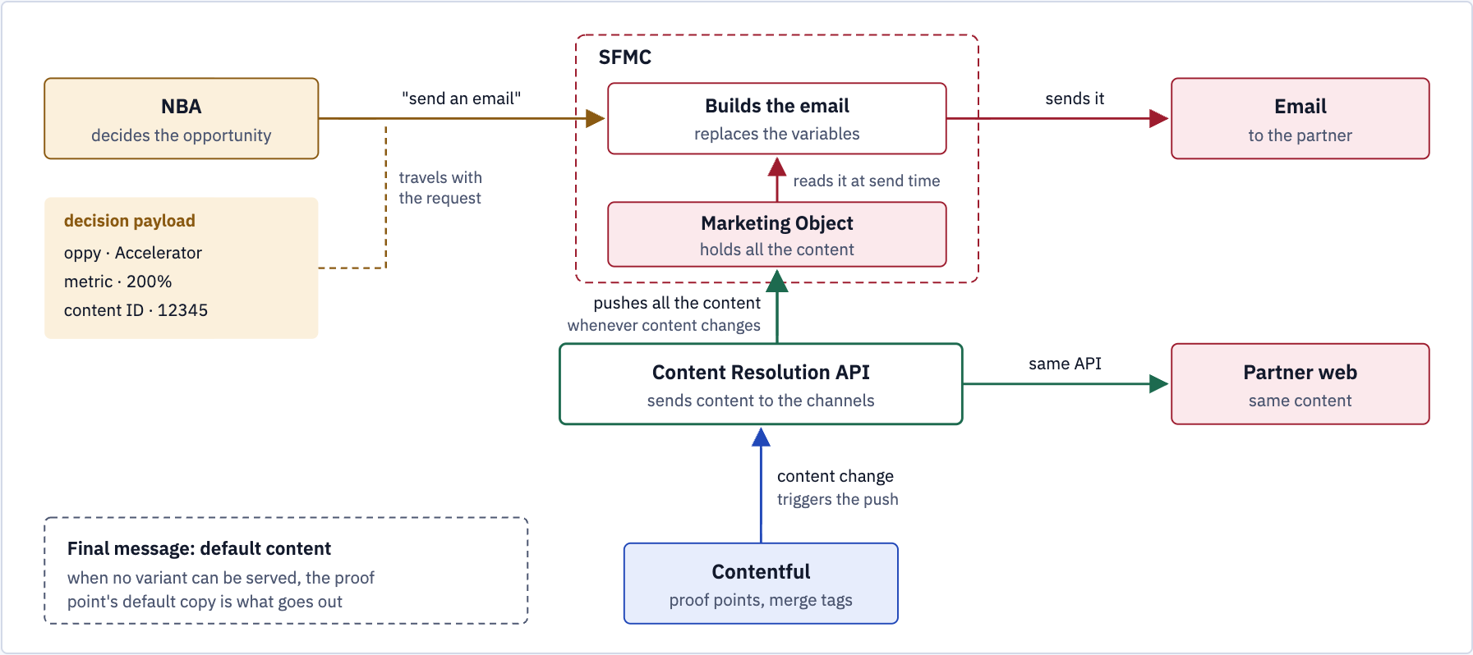
The send, end to end
Contentful pushes content changes to SFMC; at send time SFMC fills in NBA’s values and sends.
Globant proprietary | Confidential information | Do not share without EXPLICIT Globant consent
2
Notes:
Figure 13. Whenever content changes in Contentful, the Content Resolution API pushes all of it to a Marketing Object in SFMC. At send time SFMC reads the Marketing Object, replaces the variables with the values NBA sent and sends the email. Partner web reads the same content through the same API. When no variant can be served, the default content goes out.

Slide 28
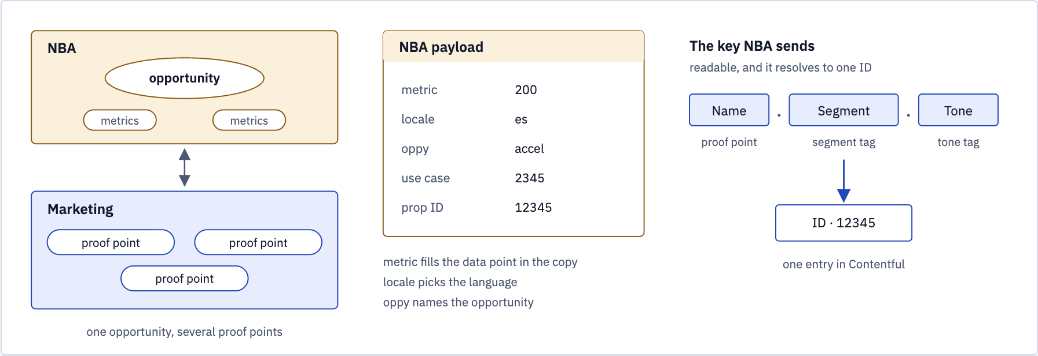
What NBA hands over
The payload carries the values; the key names the content.
Globant proprietary | Confidential information | Do not share without EXPLICIT Globant consent
3
Notes:
Figure 14. The payload carries the values; the key names the content. Proof point name, segment and tone resolve to one entry ID.

Slide 29
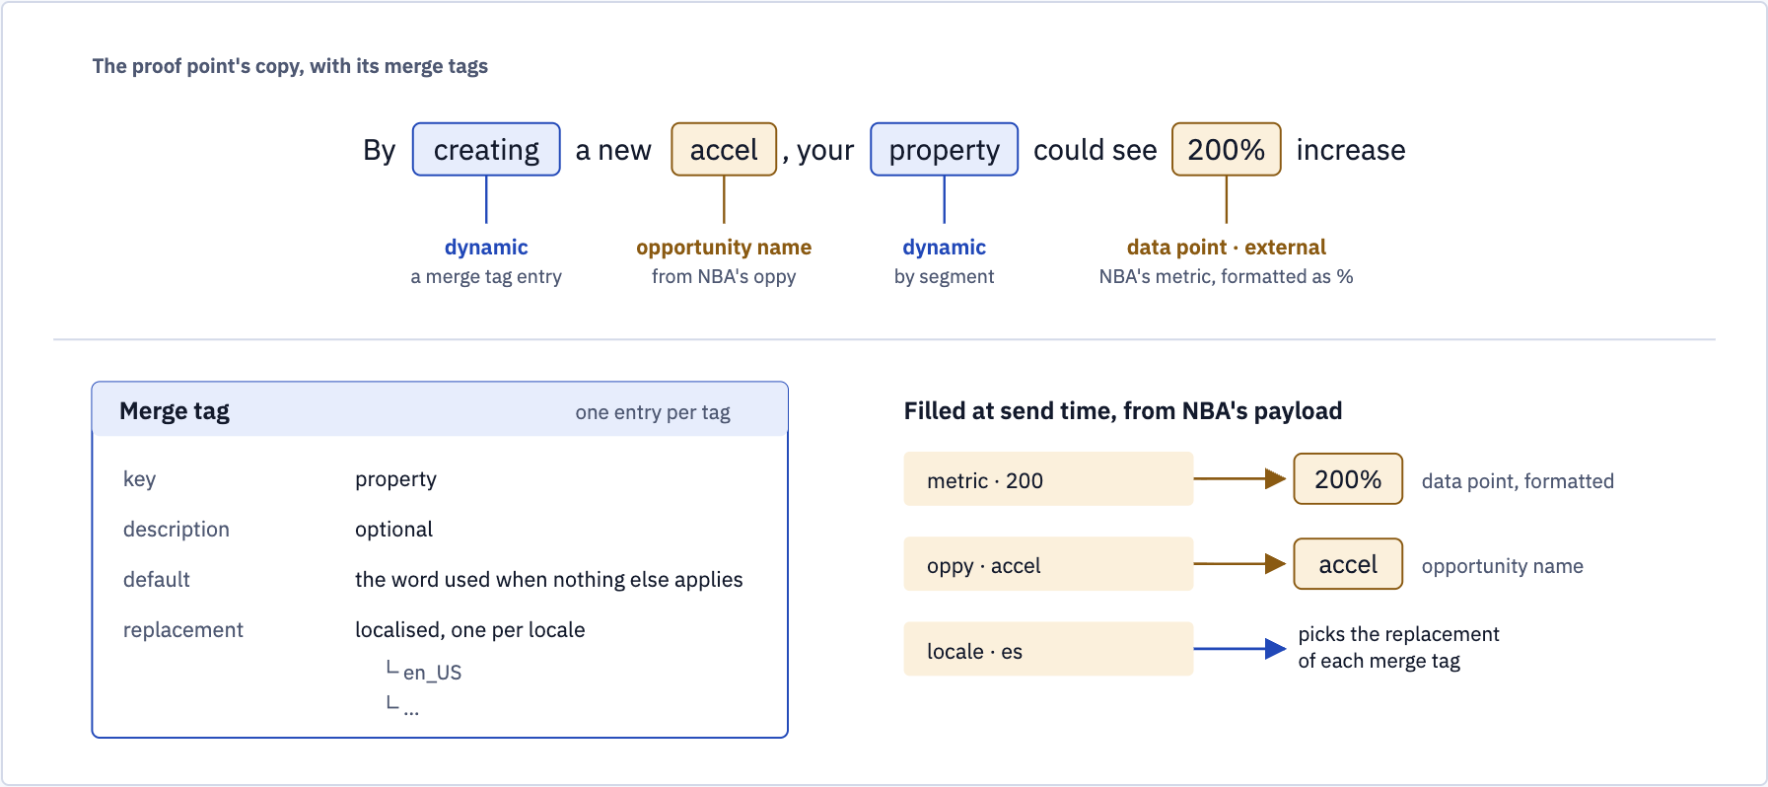
Merge tags in the copy
Dynamic tags are entries of their own; NBA’s values fill the rest when SFMC builds the email.
Globant proprietary | Confidential information | Do not share without EXPLICIT Globant consent
4
Notes:
Figure 15. Dynamic tags are entries of their own, with a default and a replacement per locale; the opportunity name and the data point take NBA’s values when SFMC builds the email.

Slide 30
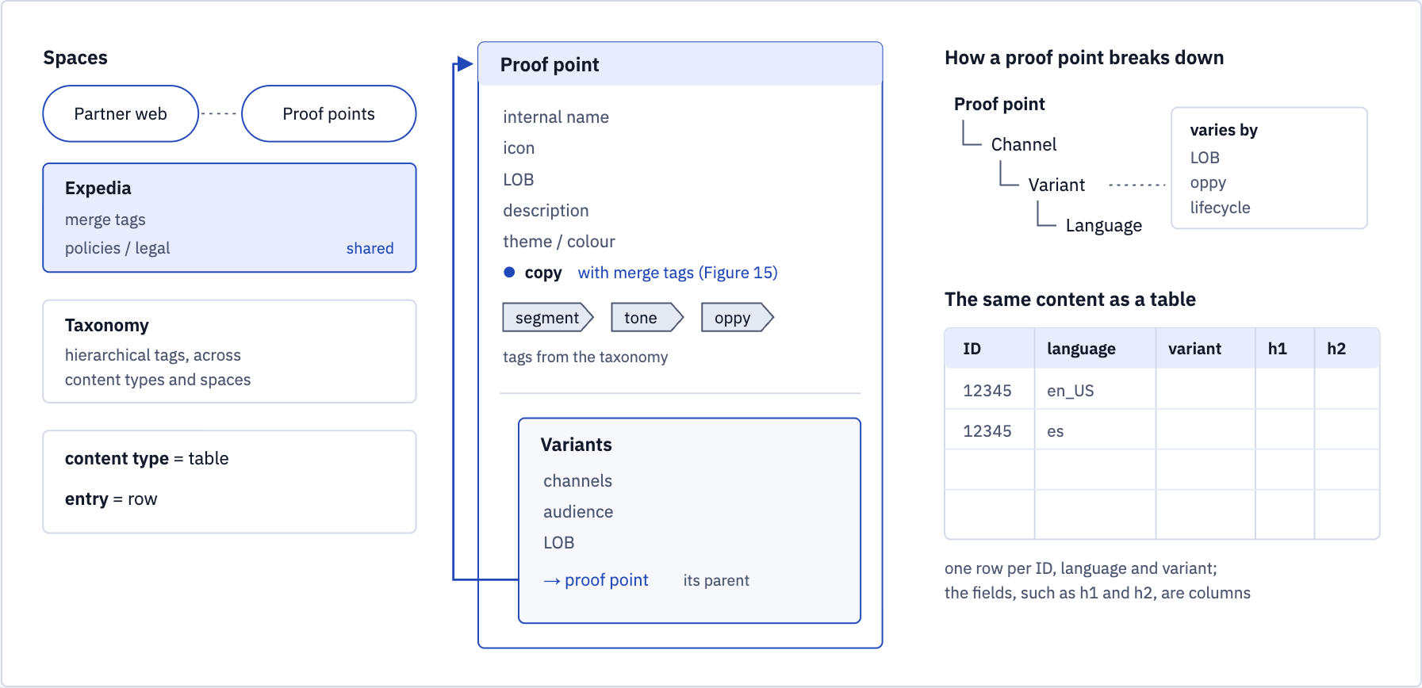
The content model behind it
Shared Expedia space for merge tags and legal copy; a proof point breaks down by channel, variant and language.
Globant proprietary | Confidential information | Do not share without EXPLICIT Globant consent
5
Notes:
Figure 16. Merge tags and policies / legal copy sit in a shared Expedia space, and the taxonomy’s tags work across spaces. A proof point breaks down by channel, variant and language.

Slide 31
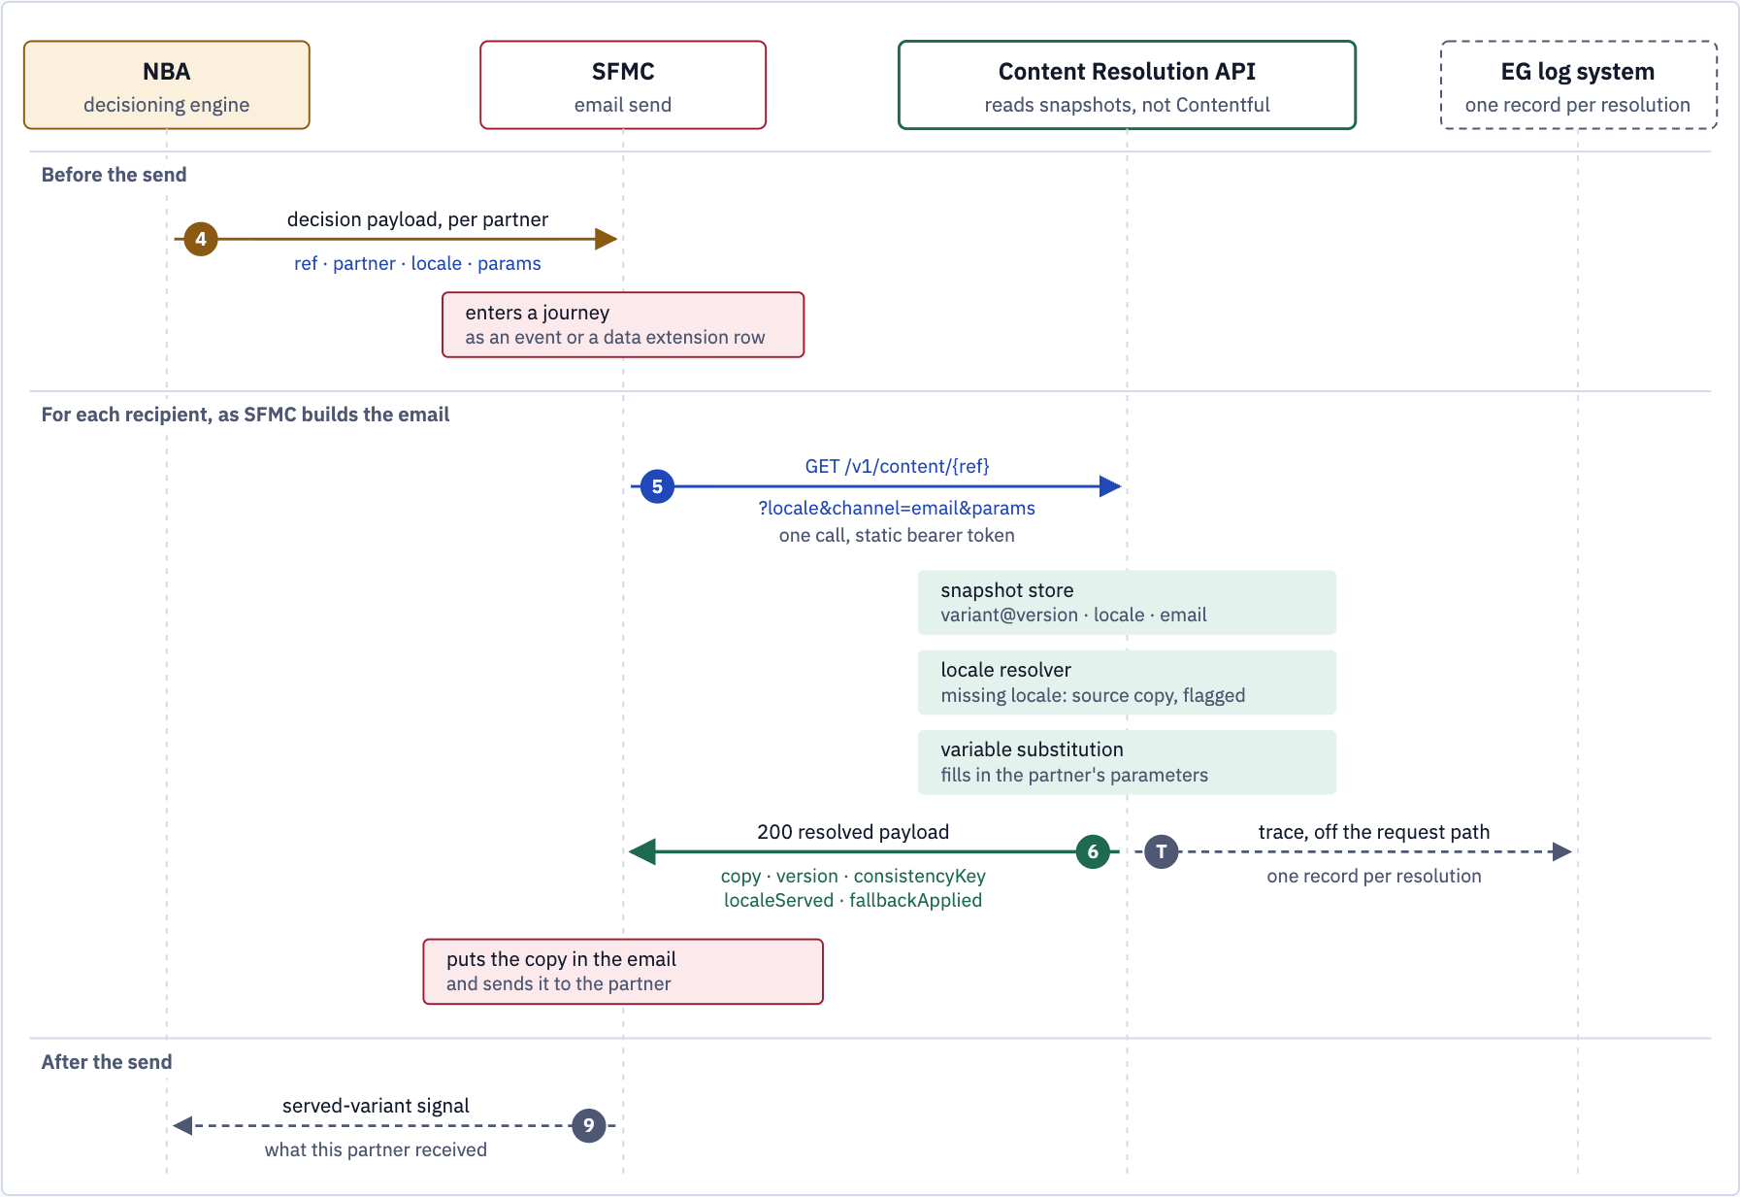
SFMC at send time, zoomed in
Three steps inside one call to the Content Resolution API; none of them reads Contentful.
Globant proprietary | Confidential information | Do not share without EXPLICIT Globant consent
6
Notes:
SFMC at send time, zoomed in. The three steps on the Content Resolution API happen inside the one call, and none of them reads Contentful. Solid arrows are synchronous requests; dashed are asynchronous. Step numbers follow the consumption flow.

Slide 32
Salesforce
API
Timeline, Team & Commercials

Slide 33
“API” Implementation Timeline
Indicative plan, eight weeks from kick-off to the Content Resolution API live as a Contentful app.
W1
W2
W3
W4
W5
W6
W7
W8
Design and API contract
Endpoint, payload, snapshot model, auth
Contentful app foundation
App set up and hosted in EG’s organisation
Snapshots and Marketing Object
Publish on content change, push to SFMC
Resolution endpoint
Locale resolver, variable substitution, fallback
NBA and SFMC integration
NBA payload in, resolved copy into the send
Testing, performance, security
Burst after a large send, failure paths
Go-live and hand-over
Release in EG’s accounts, documentation
Design agreed
First email in sandbox
Live in production
Depends on EG providing access to its Contentful organisation, an SFMC sandbox and a sample NBA payload from week 1.

Slide 34
Salesforce
API
Commercials

Slide 35
Economic Proposal
Budget & Cost Breakdown
Project
Contentful Implementation
SF Studio Contact
Tammy Kelly
Solution Specialist
tamara.kelly@globant.com
Executive Contact
John Bailey
Managing Director
john.bailey@globant.com
Description
Salesforce Contentful Implementation
Duration
2 Months
Engagement type
Time & Materials
Estimated Investment
$ 54,512
Next Steps
Proposal final review (Oct-15)
Contract Signing (Oct-31?)
Team Integration (Nov-1)
Terms and Considerations
Prices are expressed in US dollars and do not include taxes.
This proposal is only for estimated professional services at a high level; it does not include software licenses, hardware, Travel expenses, or Others not detailed in this proposal.
Anticipated travel expenses at 10-15% of estimated investment
The Globant team will consist of Globers from our delivery centers in LATAM, Spain, and United States.
Payment of invoices at 30 days.

Slide 36


Thank you!
Salesforce Studio

Slide 37
Salesforce
Appendix

Slide 38
Salesforce
Salesforce Studio

Slide 39



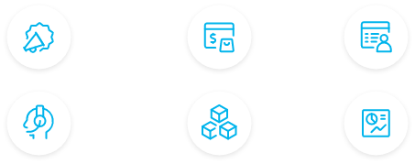














We are a Summit Salesforce Partner and have been partners since 2003.
Salesforce Studio
Our global team of Salesforce certified professionals have conducted projects for leading organizations around the world using Salesforce technologies. We have been recognized as one of Salesforce’s most innovative partners.
Enabling customer centricity through Salesforce
Using Salesforce and its partner ecosystem, we enable organizations to transform their businesses, drive desired outcomes, and build customer loyalty and growth. Our clients create better experiences through our Salesforce services as we help them build augmented digital engagements for their customers, partners, and employees.
Major Player for Worldwide Salesforce Implementation Services 2021
Major Contender for Salesforce Industry Cloud Services PEAK Matrix Assessment 2023
Practices
Digital Marketing
E-Commerce
Customer
Data Management
Strategy
Continuous
Transformation
Implementation
Analytics
Sales &
Customer
Service
Application
& Data Integration
Salesforce Industries
Cloud Experts
Marketing
Cloud
Sales Cloud
Revenue Cloud
Commerce
Cloud
Service
Cloud
Tableau CRM & Tableau
600+
2200+
3570+
4.8/5
500+
Projects Implemented
Salesforce
FTEs
Salesforce Certifications
Customer Satisfaction
Customers
Experience
Cloud
Net Zero
Cloud
Salesforce
Industries
Mulesoft
Integration
Slack
Globant proprietary | Confidential information | Do not share without EXPLICIT Globant consent
Notes:
Utilizing our deep expertise across the Salesforce platform along with the ability to enable customer centricity and productivity at scale, our goal is to unlock the Art of the Possible as you embark on this strategic transformation
Some key highlights:
We’ve been a partner of SF since 2003
We provide end-to-end services from hands on keyboard to strategic visioning across multiple verticals - particular excellence in MarTech Transformation.
We strive to transform businesses and engage in 3 ways - Digital Transformation, Capacity/Staff Augmentation, or via Managed Services.
Lastly, the acquisitions Globant has made in the last several years, highlights the growth of the studio and our continued investment to support your strategic initiatives.
In the next few slides, we will dive into the specifics around Data360 expertise.

Slide 40



Globant + Contentful - At a Glance
An end-to-end process…
2
Global sites fully migrated
10
Markets
4
Languages
+3K
Pages
+10
Contentful specialists
6
Years of experience
Our expertise:
check
Roadmap and prioritization
check
Content matrix creation
check
Content migration
check
Content publishing / authoring
check
Localization
Globant proprietary | Confidential information | Do not share without EXPLICIT Globant consent

Slide 41
Salesforce
Customer Success

Slide 42


Content migration & High-Pressure publishing
Industry: Industrial automation, software, and infrastructure solutions
Regions: USA & China during migration | +10 regions post migration
Origin CMS: SmartCMS | Scope: Main global site
Volume: +1,100 pages updated and 77 core pages rebuilt
Content Complexity Challenges
• Delayed project: The migration had been ongoing for 2 years with the deadline pushed back twice prior to our involvement.
• Unstable environment: Components and taxonomy were still being created while pages were actively being built.
• Constant rework: The lack of upfront definition led to rework on every single entry up until the day before the new site launch.

Slide 43
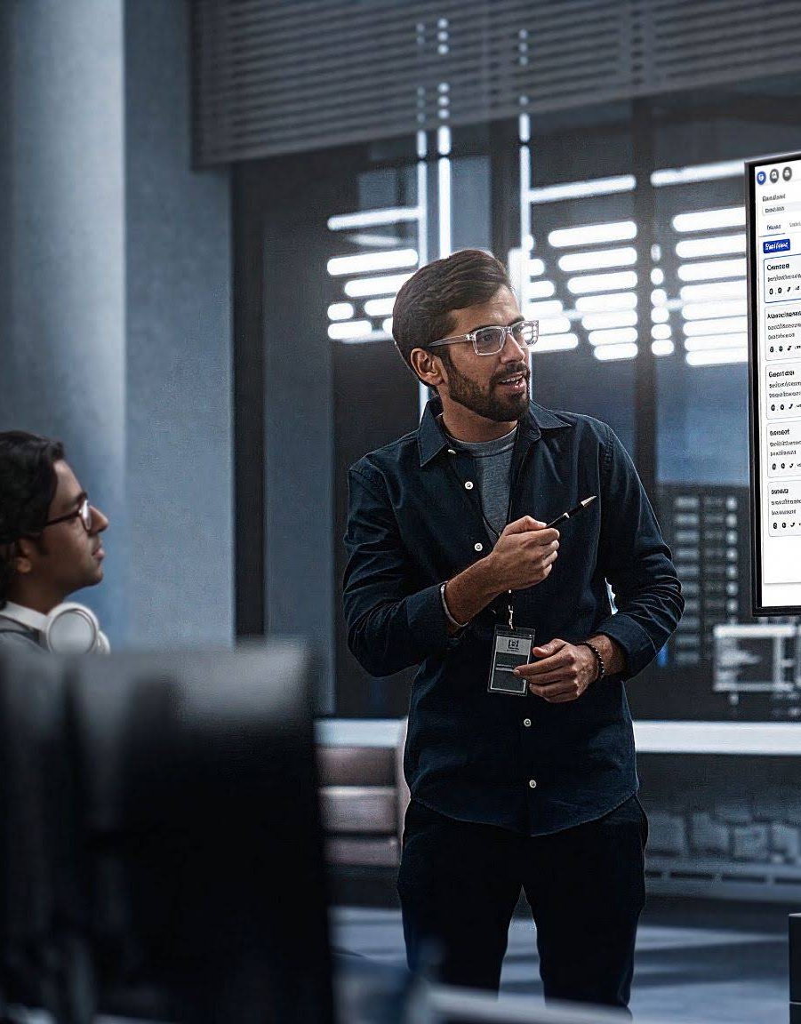
Content migration & High-Pressure publishing
Content Migration Impact
• Emergency task force: GUT BA Services brought in for final 3 weeks to hit delayed deadline.
• Operational capacity: Deployed a 6-person squad under high-pressure conditions.
• Cleanup & localization: Cleaned links, localized content, rebuilt pages.
Post Migration Support
• Velocity maintenance: Maintained publishing speed, updated assets, and built modular landing pages across regions.
• Governance & tech debt: Auditing and resolving post-migration technical debt in Contentful.
6
Content Specialists
Scaled squad in record time
+1,177
Pages
Processed, updated, & rebuilt
+25
Content Types
Up to speed in 3 weeks
+300
Pages Post Migration
Built from scratch

Slide 44


Global scaling & content consolidation
Industry: Construction
Regions: USA, Canada, LATAM, UK, Germany, France, UAE, Australia, Singapore.
Origin CMS: Magnolia | Scope: 1 global site, 4 languages, and 3 English variations
Volume: Over 3,000 pages successfully migrated.
Content Complexity Challenges
• Content Duplication: Separate, duplicated pages existed for each language and localization, creating a highly inefficient management process.
• Unstructured Data: Existing content lacked architecture, hindering CMS scalability and authoring speed.
• Operational Bottlenecks: Average page build times were excessively long (up to 3 hours per page)

Slide 45

Global scaling & content consolidation
Content Execution
• Legacy Content Audit & Rationalization: Conducted a comprehensive pre-migration assessment to consolidate, rework, or deprecate legacy content prior to Contentful ingestion.
• Content Modeling: Unstructured content was systematically organized into purpose-built content types.
• Content Rationalization: Headings transformed into baked template content.
Post Migration Support
• Continuous Optimization: Provided ongoing support for 3+ years, building and publishing pages while assisting in long-term maintenance.
• Operational Assurance: Managed daily page creation, QA, and publishing across 10 localized regional sites with zero downtime.
2
Hours Optimization
Drastic reduction in build time per page
100%
Reusable Content
All content types became fully reusable
5 years
Client Relationship
Of trusting partner relationship

Slide 46

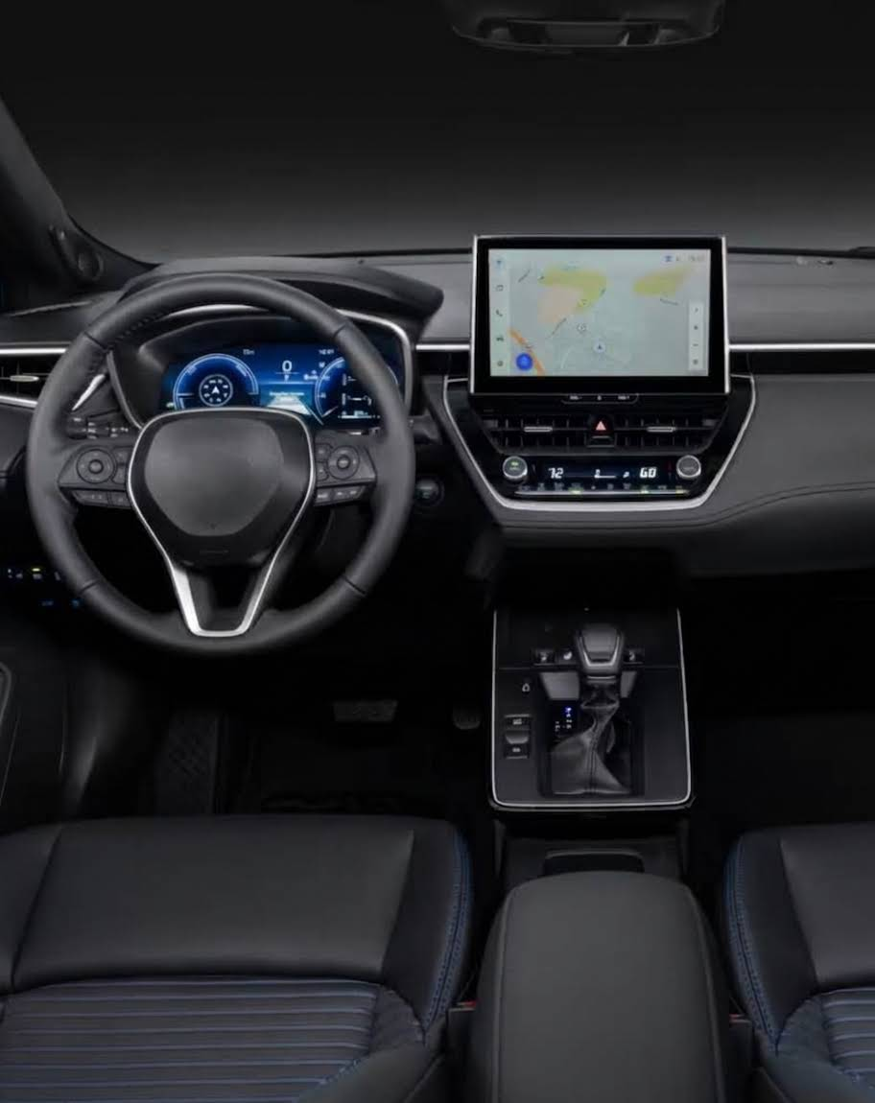
Contentful Governance & Publishing Operations
Industry: Automotive
Regions: USA (three states)
Scope: Content model optimization, cross-team alignment, and publishing governance
Volume: 13 products + 500 assets (features per product)
Content complexity challenges:
• Lack of upfront scope definition: Content publishing requirements were ill-defined because tool specifications had been finalized prior to Contentful configuration.
• Absence of content inventories: No content matrices existed to forecast, track, or calculate the total volume of content required for creation.
• Evolving product baseline: Content creation was initiated while core product strategy and feature definitions were still actively shifting.

Slide 47

Contentful Governance & Publishing Operations
Content Execution & Impact
• Cross-Functional Synergy: Strategic alignment with Contentful tech teams, product managers, and stakeholders to triage content.
• Configuration Audits: Continuous reviews driving architectural fixes, reducing friction, and boosting agility.
• Publishing Protocols: Standardized content protocol ensuring predictable delivery and milestone hits.
Operational Impact & Value
• Agile Decoupling: Established robust content creation workflows despite evolving product target definitions.
• Structured Governance: Transformed unstructured content efforts into a scalable, protocol-driven publishing pipeline.
+500
Features Published
Each product included +40 variations
6 month
Time-to-Market
Delivered full live launch through rapid configuration
27
User Guides Created
For Contentful Entries and Content Types

Slide 48
Salesforce
Methodology

Slide 49



Agile Methodology
Agile scrum methodology is a project management system that relies on incremental delivery. Each iteration consists of two-week sprints, where the goal of each sprint is to build the prioritized deliverables.
DoR
Definition of ready
DoD
Definition of done
Daily
15min
Deliverables Backlog
Sprint
(2 weeks)
Sprint Backlog
SQUADS
Sprint Deliverables
Business goals
Planning
Sprint Planning
Sprint Review
Retrospective

Slide 50
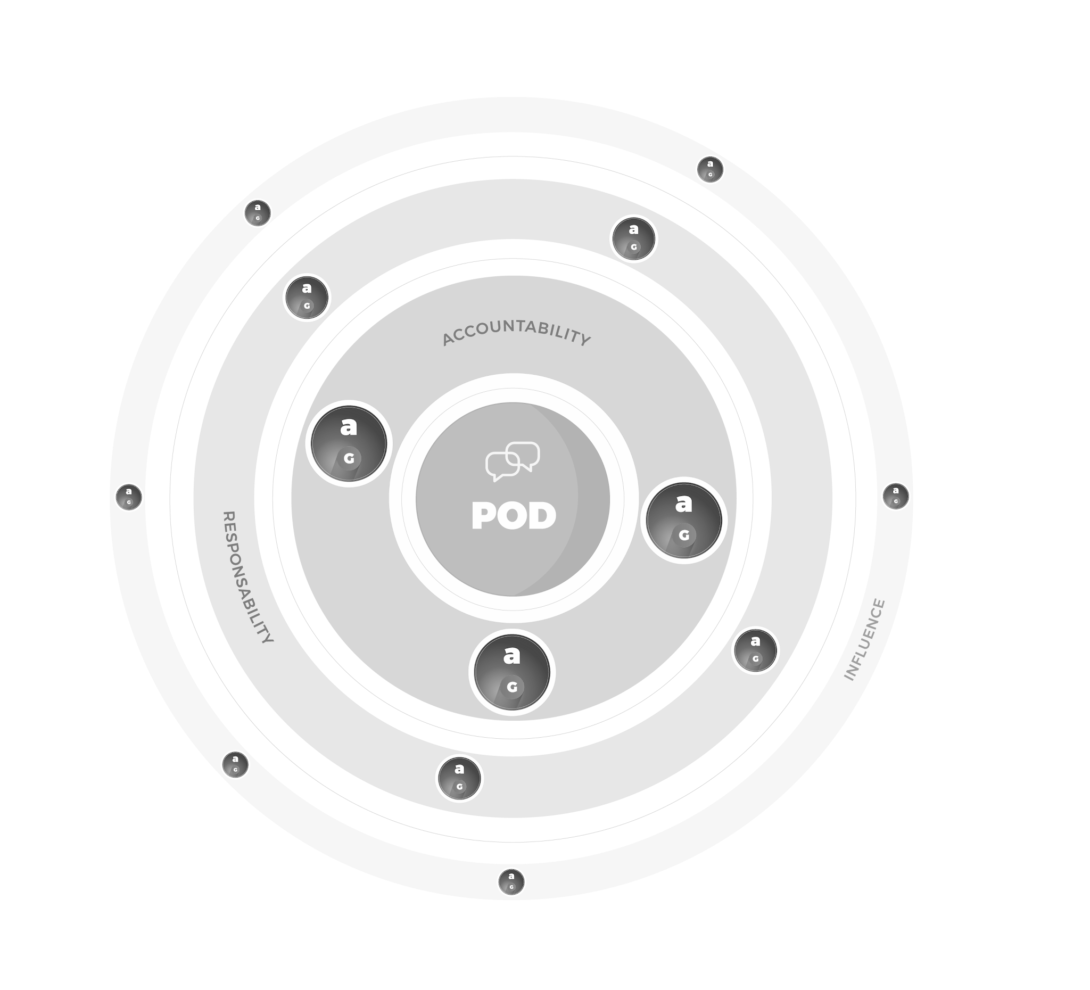





Agile PODs Model
What is a POD
How our Model Fits our Clients
How we scale
Maturity
Agile team with blended skills
Flexible model to adapt profiles according to demand changes
Sized at 3-10 Globers
Fully responsible for creating solutions, building and sustaining features, products or platforms
Self organized to meet creative and production goals, make tech decisions and reduce risk
Designed to scale, as program evolves
Mitosis can be used to create new autonomous or hybrid teams
We can upscale, downscale, and rescale according to clients’ needs (Any profile from our Studios)
Model Dimensions
A seed POD that fits within the existing Client’s team
Culture and business knowledge is naturally transferred to Globant team members
Impact
Quality
Velocity
Autonomy
Productivity
Risk
Level 1
Level 2
Level 3
Level 0
Mitosis
DEV
DEV
DEV
TL
TL
DEV
PM
POD 1
DEV
PM
POD 2
DEV
POD
DEV
UX
UI
TL
TL
UX
UI
VD
POD 3
VD
PM
TL
Mitosis
UX
UI
Areas of focus assigned by POD type
(STRATEGY | EXPERIENCE | BUILD)
VD

Slide 51


Project POD
Globant Side
Expedia Side
Subject matter expert: Assures the creation of a clean and consistent technical vision of the products
Product Owner: Responsible for any definition during the project. Must assure that the POD has timely access to client’s assets to complete the project
Project Manager: Responsible for coordinating the POD day by day. Overall management for project and support execution
Marketing: Provides all assets needed for project implementation including emails, copies, images,etc. Validates implemented campaigns
Marketing Cloud Architect: the strategic and technical visionary of the project. Beyond designing the data architecture, integrations, and governance model, they ensure the solution directly supports the client’s business objectives. They combine technical expertise with industry knowledge, guiding the project to balance performance, compliance, and scalability.
POD
IT: Provides data coming from third-party systems that need to be integrated into MC Engagement for campaign segmentation or execution
Marketing Cloud Developer: technical builder who transforms business requirements into scalable, automated solutions. They go beyond standard configurations, creating custom integrations, pipelines, and advanced logic

Slide 52
Assumptions
Collaboration is essential for project success. Globant assumes the client will designate a Product Owner for communication, coordination, approvals, and access to required information.
The execution in time and form of this proposal will depend on the adequate and timely provision by the client (or other third parties involved) of access to the applications, documentation, and assets related to the project.
The client will also define a technical point of contact who will facilitate the technical engagement and interaction with all required stakeholders.
It is assumed that the client will deliver complete, validated technical documentation of the Adobe environment (data, journeys, integrations), along with the purchase/availability of the sending domain and all access and pre-requisites marked as "Blocking" in the table above, before the close of discovery (2 weeks).
Content pieces (templates, graphics, copy) must already be finalized and approved by the client prior to implementation, so they are ready to be built directly in Marketing Cloud without additional review cycles.
Databases to be migrated must be delivered clean, active, and purged (deduplicated, with invalid/stale records removed) by the client. This engagement does not include data cleansing services, deduplication, data quality remediation, or any other workstream not explicitly defined as part of the migration scope in the SOW.
The SFMC team will provide the exact technical specifications for the required DNS records, but the insertion of those records is the client's exclusive responsibility and must be completed in the first days of implementation so as not to delay the domain warm-up plan.

Slide 53
Assumptions
Marketing Cloud Next manages IP reputation dynamically, so manual IP warm-up does not apply; however, domain warm-up remains a necessary gradual process. Any delay in Adobe environment documentation, domain availability, DNS record insertion, content approval, or database readiness on the client's side will directly impact the proposed continuous implementation timeline and may trigger the stop/freeze described above, as well as scope changes identified during discovery.
The Data 360 instance must be contracted and activated the day the project starts.
This proposal is for professional services only; no hardware or software license provision is included.
The work described in this scope is limited by the capabilities of the tools and their editions according to the license that has been contracted by the client.
Globant PODs proposed in this document do not support, implement, or develop on any third-party tool.
All resources, unless expressed otherwise, are based in Globant facilities.
Once the location of each team member is approved, the client will assume the transportation and accommodation expenses of the Globant professionals if they need to travel for the materialization of the service.
The service will begin at least four (4) weeks after the contract is signed.
This proposal doesn’t consider activities related to creating different tool documentation to the existing Salesforce documentation, which is available on the help.salesforce.com website. The POD will provide documentation for planned integrations and data models.
Ensuring the quality of the data to be uploaded into Data 360 is a task and responsibility of the client. The client must also debug the information before it is uploaded to Data 360.

